Slide 1

Problems on min Random Variable

Slide 2
Reference
Data
Youtube
Code

Slide 3
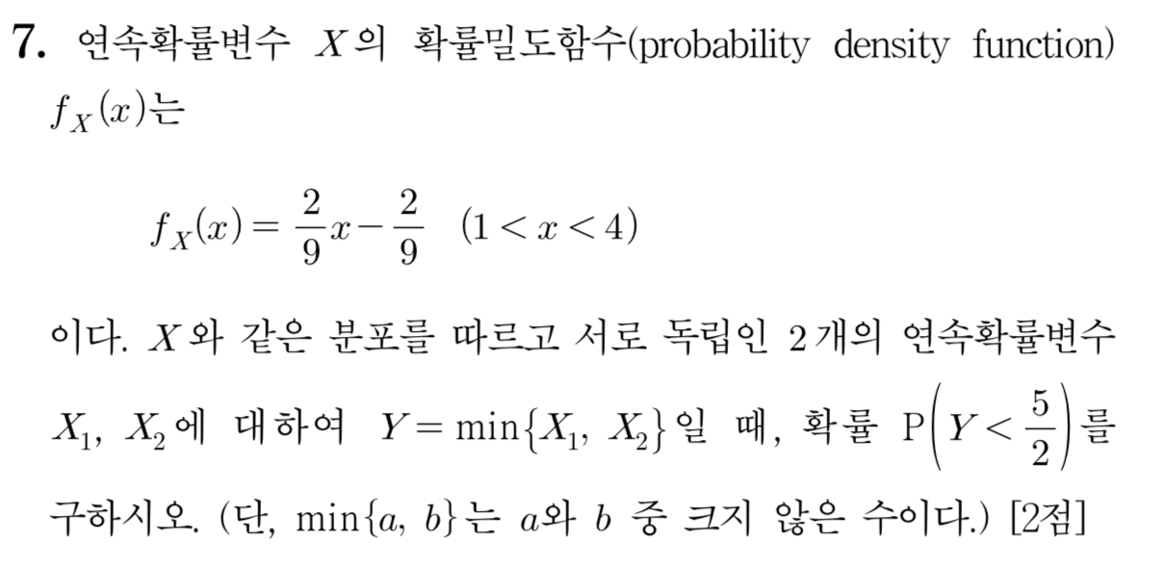
[2017]

Slide 4
